Slide 2
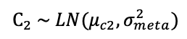

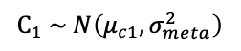
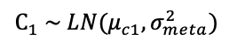
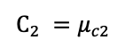
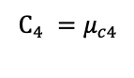
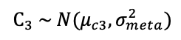
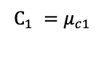
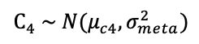
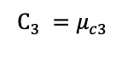
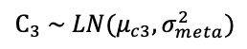
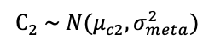
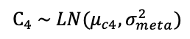

Standard SDT (no meta noise)
Gaussian meta noise
Lognormal meta noise
Meta level
Confidence criterion
(C)
$$C_{1} =μ_{c1}$$
$$C_{3} =μ_{c3}$$
$$C_{1} \sim N\left(μ_{c1}, σ_{meta}^{2}\right)$$
$$C_{3} \sim N(μ_{c3}, σ_{meta}^{2})$$
$$C_{1} \sim LN(μ_{c1}, σ_{meta}^{2})$$
$$C_{3} \sim LN(μ_{c3}, σ_{meta}^{2})$$
$$C_{2} =μ_{c2}$$
$$C_{4} =μ_{c4}$$
$$C_{2} \sim N(μ_{c2}, σ_{meta}^{2})$$
$$C_{4} \sim N(μ_{c4}, σ_{meta}^{2})$$
$$C_{2} \sim LN(μ_{c2}, σ_{meta}^{2})$$
$$C_{4} \sim LN(μ_{c4}, σ_{meta}^{2})$$
Decision level
S₁
S₂
Stimulus activation
(X)
$$X \sim N(μ_{s1}, σ_{sens}^{2})$$
$$X \sim N(μ_{s2}, σ_{sens}^{2})$$

